Slide 1

Introduction:
Analytics Avenue For Research and Development
Talentena 2024 - ‘Wall of Visuals’ -Q1
Analytics Avenue by Subramani Arumugam is one-man revolution in building the strong data analytics community in India
Achievements:
Helped 100+ professionals in career transition
Founded the brand Analytics Avenue for Research and Development to keep a pause for unemployment
Addressed more than 10k+ students and visited 25+ Engineering colleges as a guest speaker in Tamil Nadu
1

Slide 2



Talentena 2024 - ‘Wall of Visuals’ -Q1
S. Priya

Slide 3



Problem Statement
Sales Performance Analysis
Understand the overall sales performance of the company.
Analyse which products contribute the most to total sales.
Identify the best and worst performing sales channels.
Profitability Assessment
Analyse the profitability of each product.
Identify products with the highest and lowest profit margins.
Evaluate the overall profitability of the business.
Customer Segmentation
Segment customers based on their purchasing behaviour.
Analyse the sales performance of products within each customer segment.
3
Talentena 2024 – Wall of Visuals Q1

Slide 4




Problem Statement
Discount Impact Analysis
Assess the impact of discounts on sales and profitability.
Identify the correlation between discounts and order quantities.
Evaluate whether discounts lead to increased customer loyalty.
Warehouse Efficiency
Analyse sales performance by warehouse.
Identify the most and least efficient warehouses.
Optimize inventory management and distribution
Geographical sales Analysis
Analyse sales performance across different stores
Resume
4
Talentena 2024 – Wall of Visuals Q1

Slide 5
Approach
Select Data Sources
Identify Key Metrics
Create Visualizations
Define Objective
Choose the right tools
Design Layout and Structure
Data cleaning and preprocessing
Select Visualization Types
Implement Interactivity

Slide 6
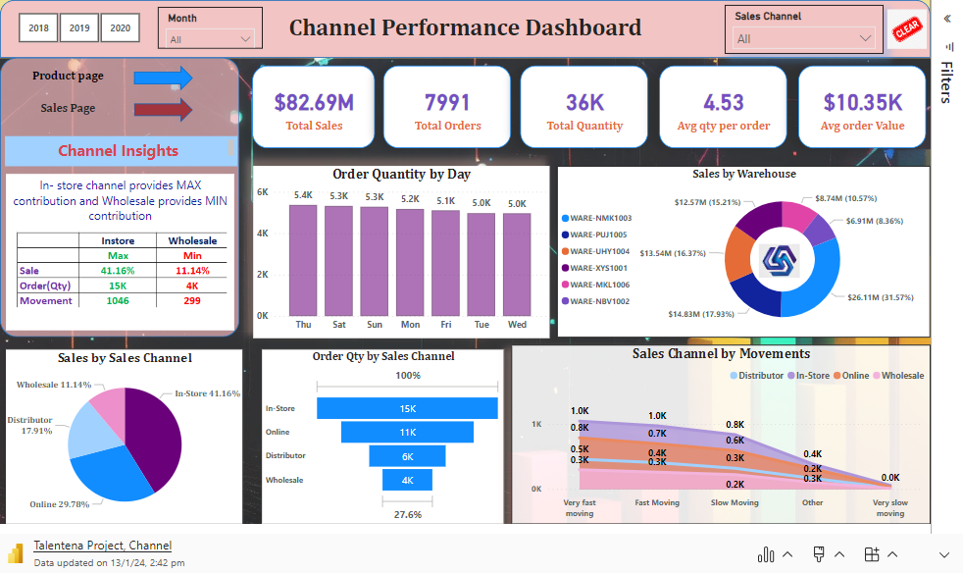
Talentena 2024 – Wall of Visuals Q1

Slide 7
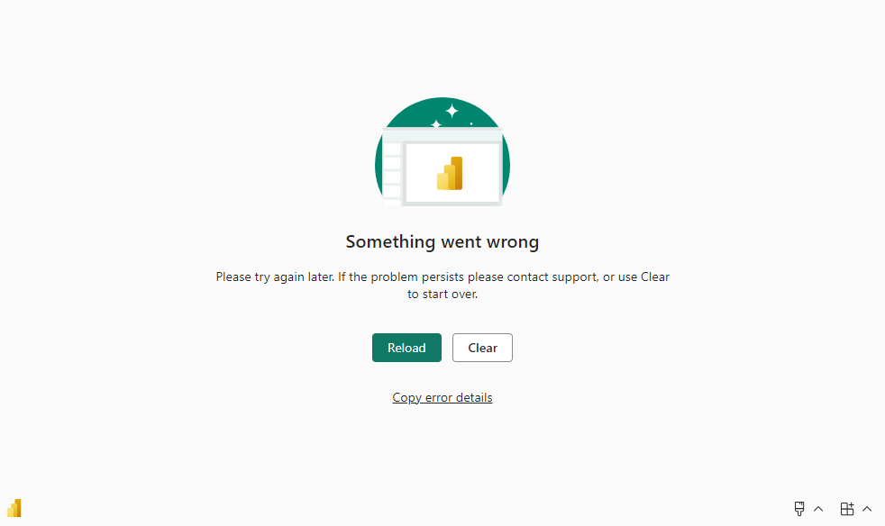
Talentena 2024 – Wall of Visuals Q1

Slide 8
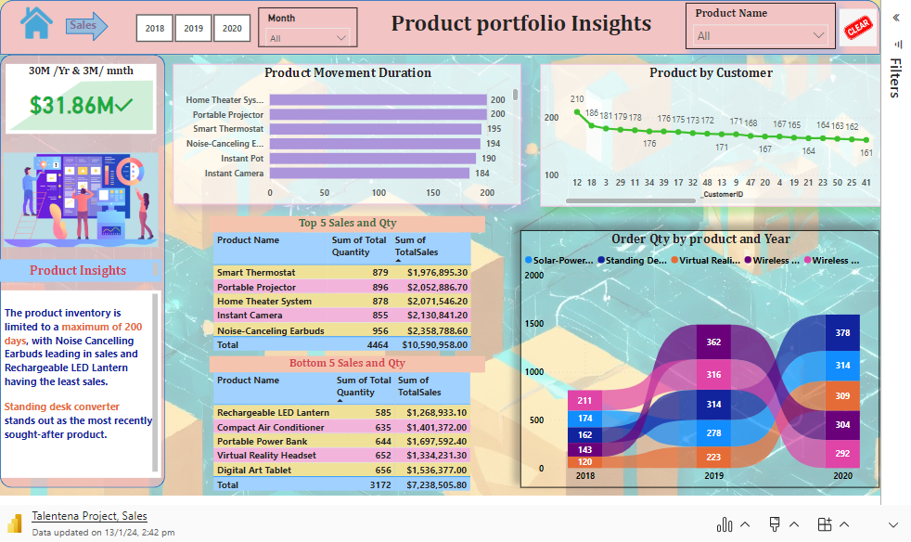
Talentena 2024 – Wall of Visuals Q1

Slide 9
Key Insights
Channel
Product
Sales
In-store channel provides MAX contribution and wholesale provides MIN contribution in number of orders placed
The product inventory is limited to a maximum of 200 days, with Noise Cancelling Earbuds leading in sales and Rechargeable LED Lantern having the least sales.
Standing desk converter stands out as the most recently sought-after product.
Store 284 has the highest sales value
With Discount, Virtual reality headset has highest Profit
Without discount, Noise cancelling earbuds has highest profit
Highest profit without discount is 0.91 M and with discount is 0.46 M
9

Slide 10








Targeted Clients
10

Slide 11

Recent use cases implemented in real world
Distributing network resources to meet demand.
Route planning for time and transport costs.
Customer management to keep them coming back.
Marketing to acquire new customers and drive revenue.
Risk analysis of potential accidents and extraordinary events
11

Slide 12
Customer Segmentation: Identified distinct customer segments based on purchasing behavior, allowing for targeted marketing strategies. High-value customers exhibit a preference for specific products and sales channels.
Key Findings:
The analysis of the dataset has revealed valuable insights into our sales and customer dynamics.
Insights and Trends:
Notable trends include a surge in online sales and a consistent preference for certain product categories.
Seasonal patterns indicate increased sales during specific months.
Product Performance:
The impact of discounts on sales is evident, with varying effectiveness across products.
Recommendations:
Implement targeted marketing initiatives aligned with identified customer segments.
Refine discount strategies based on product performance and customer response.
Explore dynamic pricing models to maximize revenue.
Thank You:
Thank you for your time and attention. Your collaboration and commitment to implementing these insights will undoubtedly contribute to the ongoing success of our business.
Talentena 2024 – Wall of Visuals Q1

